Slide 1
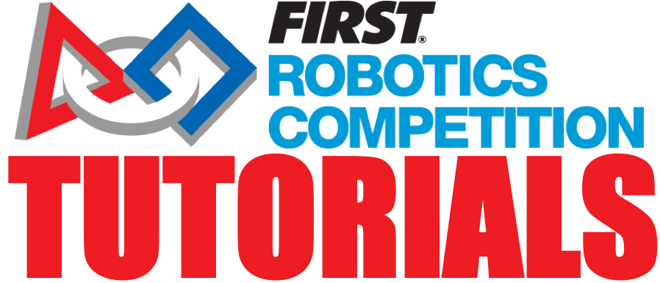
FIRST SAFETY
TEAM 2080

Slide 2
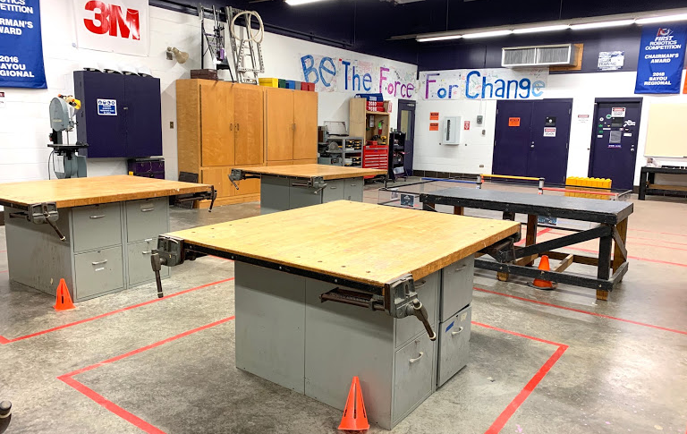
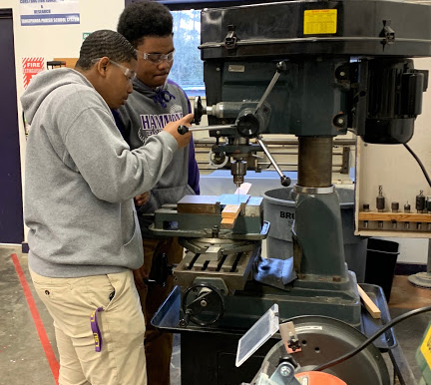
#PUTSAFETYFIRST - Why?
A safe work environment in FRC is important…
to prevent injuries and illnesses from occurring.
to engage team members in understanding their own social responsibility to the team.
to increase productivity & streamline our effectiveness.
to decrease the cost of having to replace broken items from misuse.
Your members need to know they are in good hands while working.

Slide 3
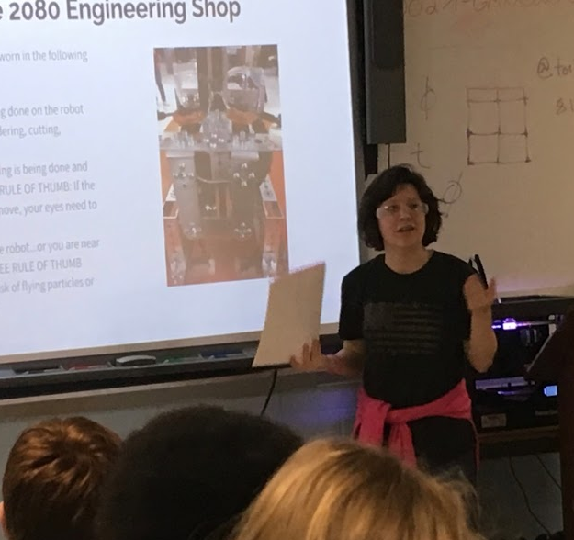
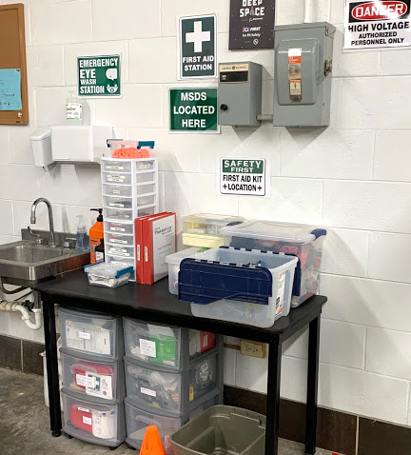
Tips to Create a Team Safety Plan
Every team should develop a thorough Safety Plan that includes team member expectations involving use of PPE, work in the shop, competitions & during outreach.
Always reference the FIRST Safety Manual. Be sure to take a look for any safety updates throughout the season & from year to year.
There are many teams who are willing to share their Safety Manual to help others get ideas for creating their own. You can find ours on our website.
All team members must be educated on proper PPE and tool usage.
Make sure you keep documentation of all shop and team safety trainings.
It’s not only for the Safety Captain to know. The entire team must be educated on your team’s safety plan.

Slide 4
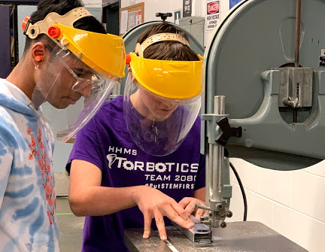
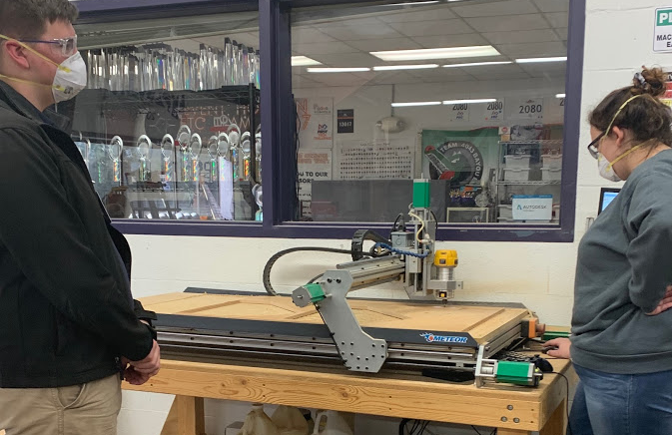
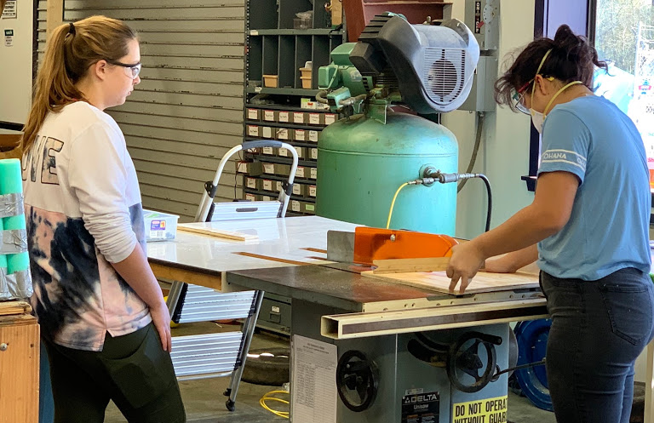
Instilling a Culture of Safety
Shop Safety
Team safety is everyone’s responsibility.
Create a safety plan specific to working with tools, machinery & proper PPE use.
We’ve developed a way to track who’s been certified to work with different machines, power tools, & electrical. This helps newer members & mentors navigate the shop.
PPE is not to be treated like an option, its mandatory but exact PPE needed can fluctuate depending on the equipment used.
Your work space should have appropriate signage & a well stocked safety station. We work to maintain our shop’s annual NCCER certification.
Understand that people are going to get hurt no matter what. Make sure they know what to do when injured and who to go to for help.

Slide 5
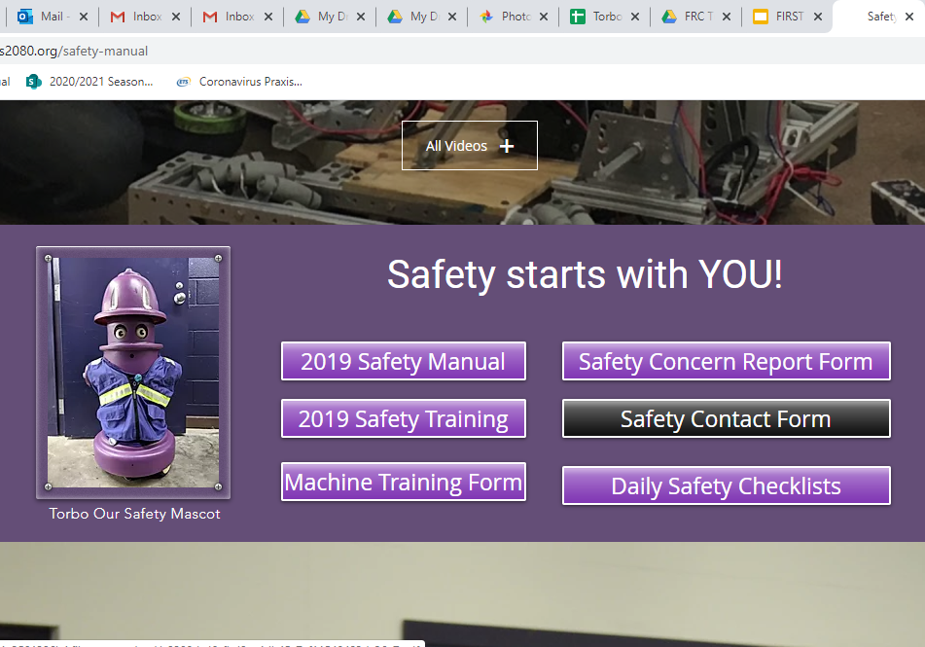
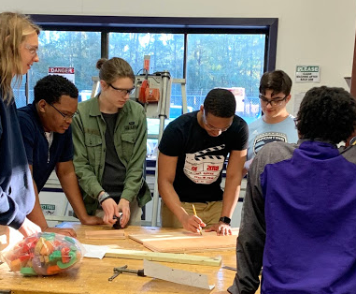
Instilling a Culture of Safety
Emotional Safety
To maximize retention & ensure an overall positive vibe, members need to feel safe. It needs to be okay to make mistakes. Your team’s overall culture is what you make of it with mentor support.
On our website, we have a safety form that can be filled out if a peer makes you feel unsafe or uncomfortable. Only our lead mentor sees the form and is there to help us.
There’s also a form where members can positively recognize peer contributions.
You have to build in ways for members take pride in being apart of your team.

Slide 6
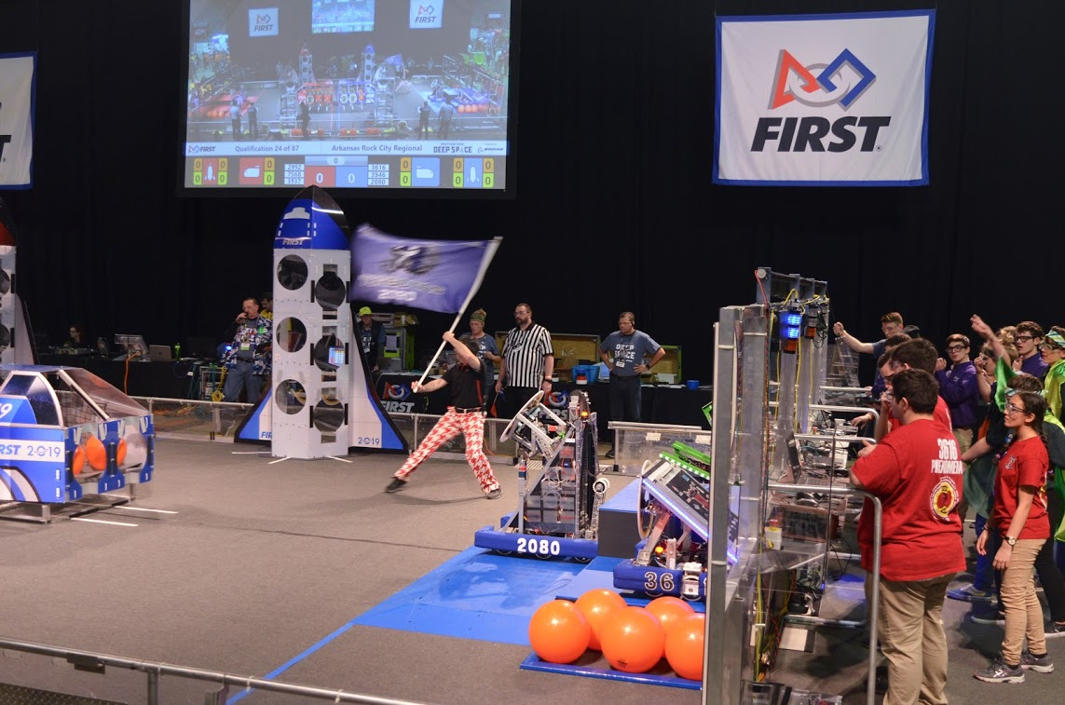
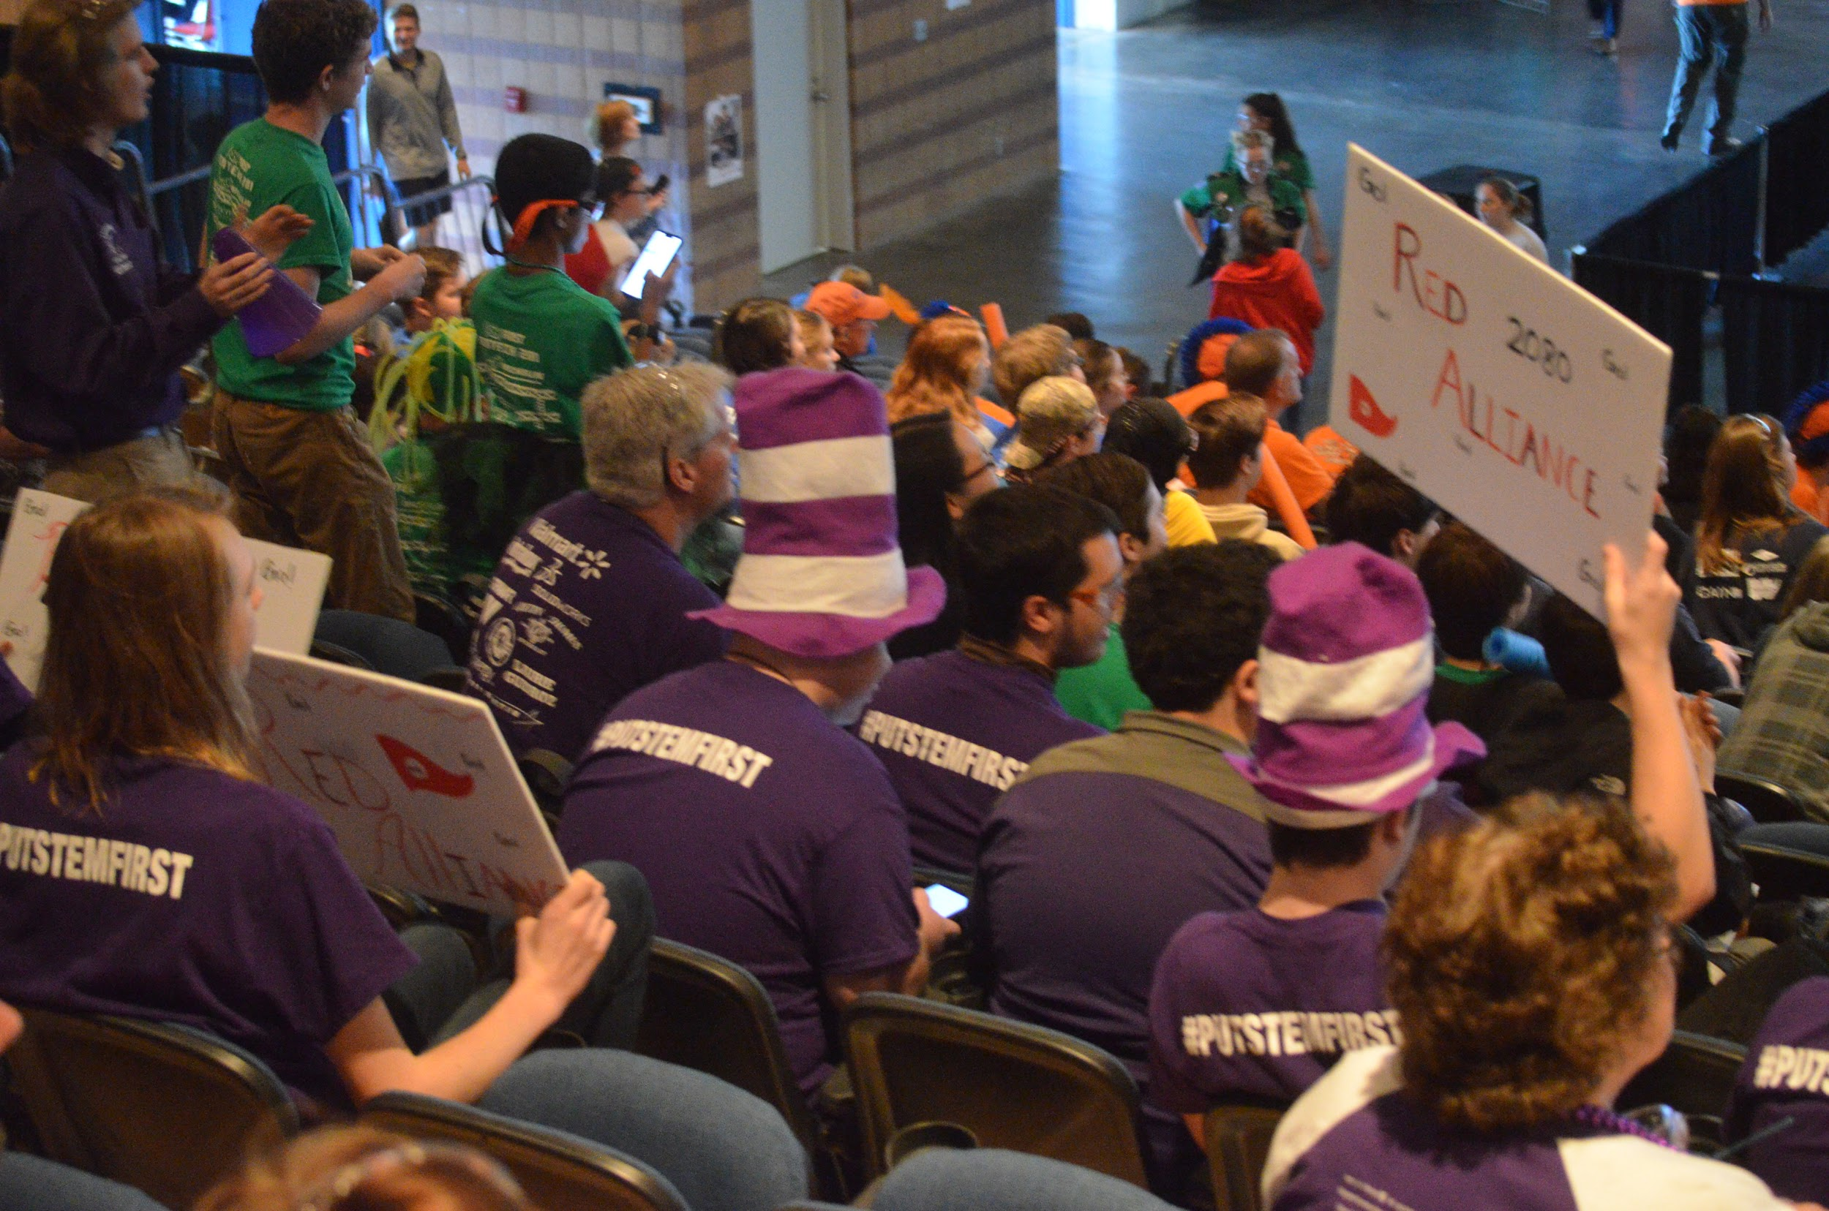
Instilling a Culture of Safety
Event Safety
Prior to each big event, we hold a mandatory meeting for members & families. We provide families with our daily schedule/agenda along with all necessary contact information.
Families fill out emergency contact forms & plans are made individual to accommodate any personal needs.
Each team member is assigned a travel partner. It’s mandatory for us that no one is alone at competitions or big events.
Prior to each event, our safety team & mentor meet to develop escape plans & designated meeting areas specific to the event. Everyone on the team is made aware of these.
Most of us are CPR, AED, & FIrst Aid certified.
We use Discord to send messages to all of our members at once if something needs to be said instantly.

Slide 7
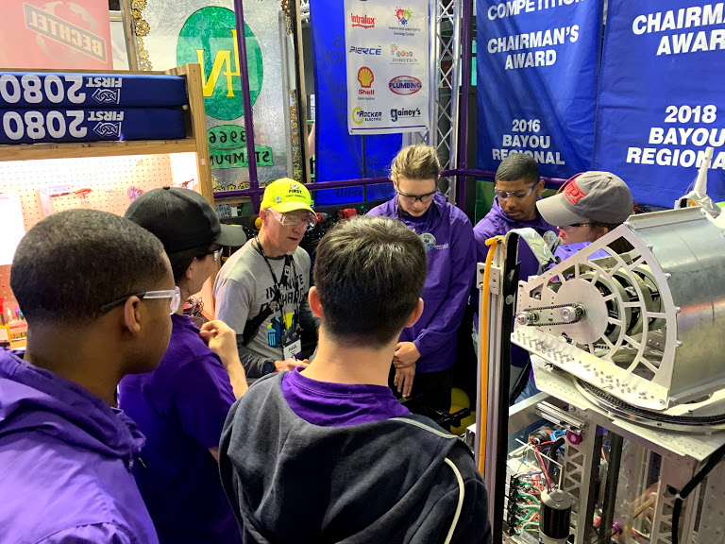
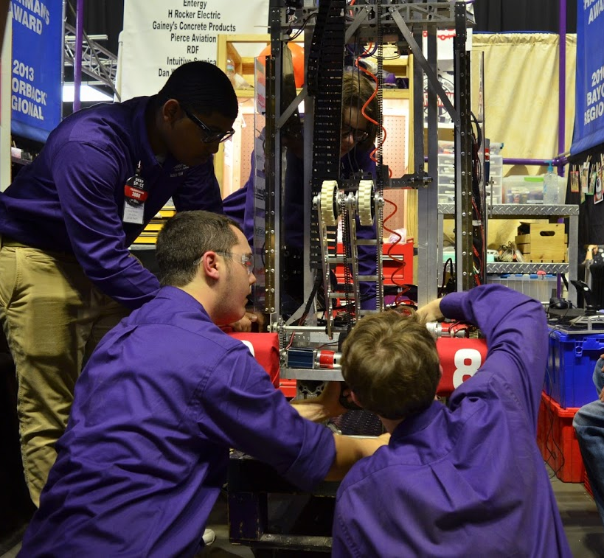
Instilling a Culture of Safety
Pit Safety @ Competitions
Limit the amount of people allowed inside the pit. It's a tight space & things can very quickly get complicated.
It works best to have a pit rotation schedule so everyone gets pit time & also gets a break. Multiple people should be trained to do different tasks including talking to judges.
Have your own safety station in your pit with hand sanitizer.
Make sure everyone is getting plenty of water and can take rests, if needed.
Be aware of your surroundings. Always travel with a buddy if you’re not familiar with the area.
Have a way to communicate with all team members in case of an emergency.
Keep your pit area clean and organized.

Slide 8
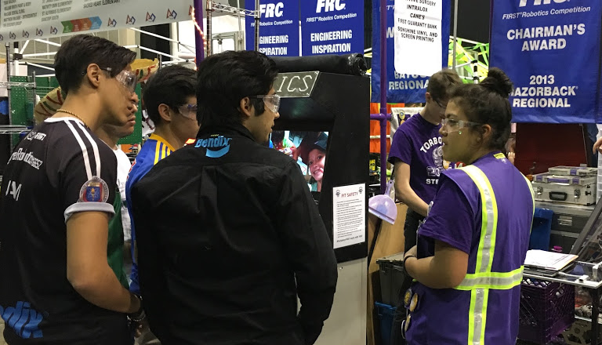
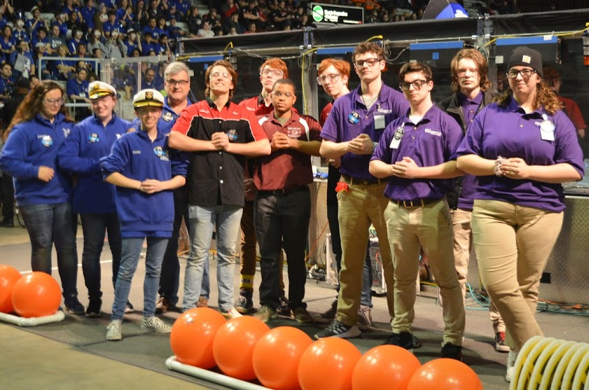
Instilling a Culture of Safety
Importance of Collaborating with other Teams
Get out and meet with other teams!!!
There's always something to gain from others.
Ask others about their safety plans and protocol to see how you can improve your own.
Always look for ways to connect with others and learn from each other. You can’t better yourself (& team) without outside help. This goes both ways!
There is nothing to lose by simply bouncing ideas off of each other, but there is plenty to gain!
Lots of teams bring safety items to competitions to share with others.

Slide 9
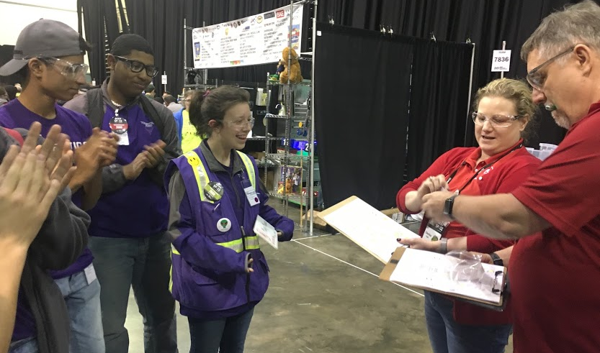
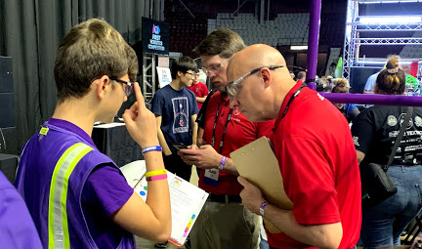
Safety Judging: What to Expect
Your team’s safety captain(s) should expect to participate in daily safety briefings at every competition.
Nerves are normal, stay calm and speak with confidence.
Decide on a few bullet points to turn into talking points, but don't prepare a speech.
Talk freely about your team’s safety culture.
What makes your team’s approach to safety unique?
Allow judges to ask questions.
Allow other members to speak. It's not just about the safety captain. All members should know your team's safety plans and protocols.

Slide 10

Credits
This lesson was written by FRC 2080 for FRCTutorials.com
You can contact the author at frcteam2080@gmail.com or www.torbotics2080.org
More lessons for FIRST Robotics Competition are available at www.FRCtutorials.com
This work is licensed under a
Creative Commons Attribution-NonCommercial-ShareAlike 4.0 International License.

